Slide 1

A Brief Intro to Android
Follow Along At:
bit.ly/1OAsAB6

Slide 2
Wait! Do you have Android Studio!?
If not, you won’t want to miss out on the labs!
developer.android.com/sdk

Slide 3
Java

Slide 4
Android’s Java
Oracle’s JDK
Apache Harmony Implementation
Java 6
Oracle’s OpenJDK
Android N
Java 8
http://harmony.apache.org/
http://venturebeat.com/2015/12/29/google-confirms-next-android-version-wont-use-oracles-proprietary-java-apis/

Slide 5
Android Framework Stack
Notes:
Point out big point of interest
Applications layer (where the apps that you usually write are going live)
App Framework
Libraries (SQLite, WebKite, OpenGL) & Android Runtime

Slide 6
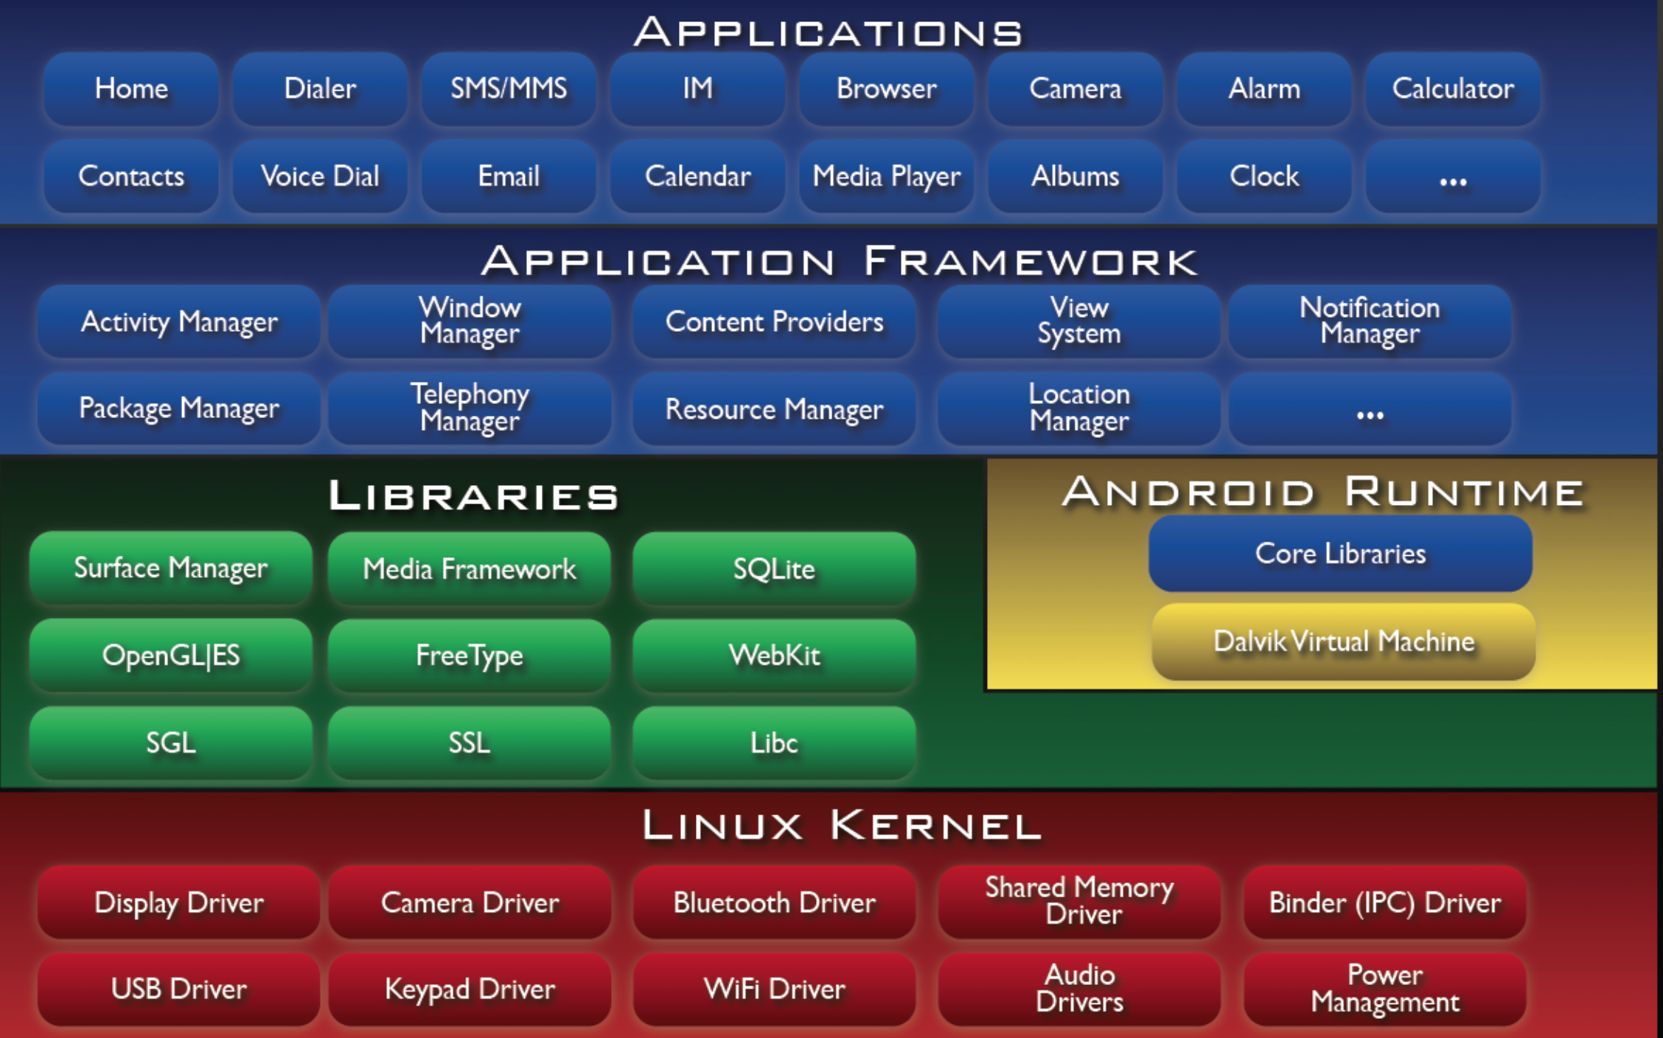

Slide 7
Core Concepts
Activity
A single “screen” that a user would see
Service
hidden from user, handles actions that persist after user navigates away from app
Ex. - A music player uses a service to continue playing music after closing app
Context
Interface to global information about an application's environment
Notes:
Basically a "screen", any single screen that a user would see. This can be a screen filled with complex controls or a completely empty screen. If the user sees it, it's an activity.
Services run in the background, where the user can't see them. Generally these are used for when you want something to happen even when the user closes the activity, for instance the default music player app has a service so you can continue to listen to music while using other apps. In our case, a ble service that takes care of scanning, connecting and registering for ble gatt notifications.
Context - Interface to global information about an application's environment. Up-calls for application-level operations such as launching activities, broadcasting and receiving intents, etc.

Slide 8
Core Concepts...cont.
Resources
Files used by code
Ex. XML, Images, Audio
R.java
Auto generated interface between src and resources
AVD (Android Virtual Device)
Simulator for testing your project without a real device
Notes:
Resource - Term for anything you use in an app that isn't code. XML, images, and audio fall under this category. There is a file called R.java in all android projects that automatically organizes resources at compile-time.
R.java - Auto generated interface between src and android resources. Used only for compilation time.
AVD - Android Virtual Device. An emulator that simulates an Android device.

Slide 9
Core Concepts...cont.
Views
the basic building block for user interface component
Persistence
SQLite at the core, 3rd Party Wrappers
SharedPreferences
App Manifest
Must be named AndroidManifest.xml in the root directory
Declares all services and components used in the app, by activity
Notes:
SQLite
SharedPreferences
3rd Party Libraries (usually SQLite Wrappers)

Slide 10
Bread & Butter - Intents
An abstract description of an operation to be performed.
External Intents
Open an URL, Share an image and/or text
Internal Intents
Start an Activity, Send a broadcast.

Slide 11
Activity Life Cycle

Slide 12
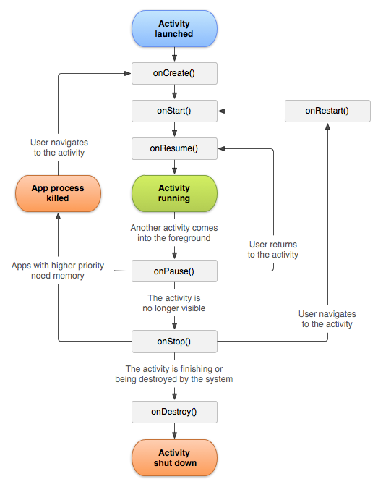
Complete Lifecycle
http://staticfree.info/~steve/complete_android_fragment_lifecycle.png

Slide 13
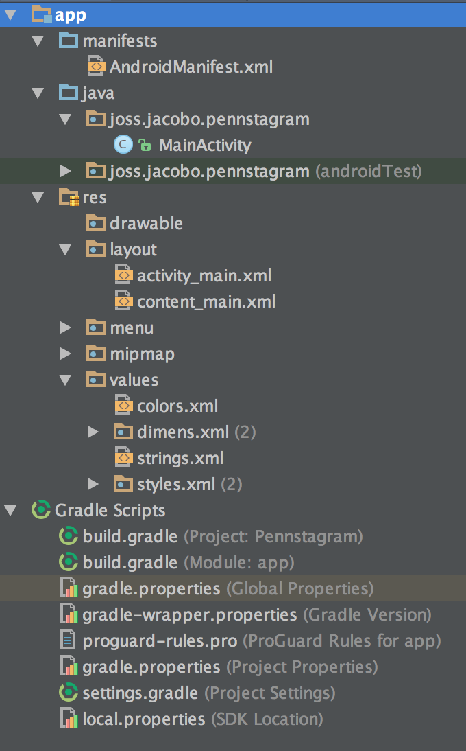
Project Structure
build.gradle files
Android Manifest
Resources Folder
Activities
SDK Manager

Slide 14
Create A New Project
Launch Android Studio
Create a New Project
Name your project “HelloWorld”
Check the box for Phone and Tablet
Add a Blank Activity titled MainActivity
Click Finish
You have a basic app!

Slide 15
Creating an Emulator
In the menu, click Run > Run App
Click the … to create a new AVD
Choose Nexus 5 and Marshmallow
Download the system image that matches your computer’s architecture. If you don’t know, choose armeabi-v7a.
You should now be able to run your app
Genymotion is a great alternative if you’re having trouble with a local AVD
https://www.genymotion.com/#!/

Slide 16
Lab 1
Hello, World!
Follow Along At:
bit.ly/1OAsAB6

Slide 17
Cloning Lab 1
github.com/willowtreeapps/penn-apps-lab1
or
bit.ly/1lzgzkR
Note: this lab is based on the excellent documentation on the Android Developer Site. A well-detailed explanation of everything in the Lab can be found at https://developer.android.com/training/basics/firstapp/index.html

Slide 18
Important Files
MainActivity.java
activity_main.xml and content_main.xml
DisplayMessageActivity.java
activity_display_message.xml and content_display_message.xml
strings.xml

Slide 19
Step 1 - Adding a Text Field
Open res/layout/content_main.xml
LinearLayout is a view group that lays out child views in either a vertical or horizontal orientation
Children appear in the order in which they appear in the XML
Add an EditText field to the view:
<EditText android:id="@+id/edit_message"
android:layout_weight="1"
android:layout_width="0dp"
android:layout_height="wrap_content"
android:hint="@string/edit_message" />

Slide 20
Step 2 - Adding String Resources
Open res/values/strings.xml
Add two string values for the help message and button text at Fill in Here
<string name="edit_message">Enter a message</string>
<string name="button_send">Send</string>

Slide 21
Step 3 - Adding a Button
Edit res/layout/content_main.xml
Within the <LinearLayout> element, define a <Button> element immediately following the <EditText>element.
<Button
android:layout_width="wrap_content"
android:layout_height="wrap_content"
android:text="@string/button_send" />
Run your app!

Slide 22
Step 4 - Responding to Send Button
Add the android:onClick attribute to the <Button> element.
Your <Button> should now look like this:
<Button
android:layout_width="wrap_content"
android:layout_height="wrap_content"
android:text="@string/button_send"
android:onClick="sendMessage" />

Slide 23
Step 5 - Build an Intent
Open MainActivity.java, and edit the sendMessage() method
Create an Intent to start the activity called DisplayMessageActivity with the following code:
Intent intent = new Intent(this, DisplayMessageActivity.class);
EditText editText = (EditText) findViewById(R.id.edit_message);
String message = editText.getText().toString();
intent.putExtra(EXTRA_MESSAGE, message);
startActivity(intent);

Slide 24
Step 6 - Receive the Intent
Edit onCreate() method of the DisplayMessageActivity.java file.
Intent intent = getIntent();
String message = intent.getStringExtra(MyActivity.EXTRA_MESSAGE);
TextView textView = new TextView(this);
textView.setTextSize(40);
textView.setText(message);
RelativeLayout layout = (RelativeLayout) findViewById(R.id.content);
layout.addView(textView);
Run the app! Fill in the text field, and see it displayed on the second screen!

Slide 25
Finishing Up
Reference version available
github.com/willowtreeapps/penn-apps-lab1-completed
or
bit.ly/1ncgyVc

Slide 26
Lab 2
Pennstagram

Slide 27
Lab 2 - Pennstagram
On this lab we’ll be creating an app that launches another Camera App, allows the user to takes a picture, and share it on social media.
All through the magic of Intents.

Slide 28
Cloning Lab 2
github.com/willowtreeapps/penn-apps-lab2
or
bit.ly/1ncgyVc

Slide 29
Step 1 - Asking Permission, Pretty Please
Open AndroidManifest.xml, and add a user-permission.
Asking for this permission will allow us to save pictures taken by the user and saved them to the external storage.
<application>
<uses-permission android:name="android.permission.WRITE_EXTERNAL_STORAGE" />
<activity>
</activity>
</application>

Slide 30
Step 2 - Linking up Views
Open MainActivity.java, and edit the onCreate() method, so that you are filling in the Step 1 Section
fab = (FloatingActionButton) findViewById(R.id.fab);
pictureText = (TextView) findViewById(R.id.text);
platyImageView = (ImageView) findViewById(R.id.platy);

Slide 31
Step 3 - Setting up Listeners
Next, fill in Step 2 with to set up a listener for the FloatingActionButton
fab.setOnClickListener(new View.OnClickListener() {
@Override
public void onClick(View view) {
if (pictureTakenBitmap == null) {
startImageCapture();
} else {
shareImage();
}
}
});

Slide 32
Step 3 - Setting up Listeners, Cont.
Similarly set up an onClickListener for the ImageView
// Set ImageView's onClickListener
platyImageView.setOnClickListener(new View.OnClickListener() {
@Override
public void onClick(View v) {
startImageCapture();
}
});

Slide 33
Step 4 - Capture the Image
Go down to startCaptureImage()and start editing it.
This method will create an Intent to capture an image and launch it. All apps installed on the user’s phone with the ability to take a picture will respond to this intent.
private void startImageCapture() {
// create Intent to take a picture and return control to the calling application
Intent intent = new Intent(MediaStore.ACTION_IMAGE_CAPTURE);
pictureFileUri = getOutputMediaFileUri(this, IMAGE_NAME); // create a file to save the image
if (pictureFileUri != null) {
intent.putExtra(MediaStore.EXTRA_OUTPUT, pictureFileUri); // set the image file name
// start the image capture Intent
startActivityForResult(intent, CAPTURE_IMAGE_ACTIVITY_REQUEST_CODE);
} else {
Toast.makeText(this, "There was an error creating the file to save the image to", Toast.LENGTH_SHORT).show();
}
}

Slide 34
Step 5 - Preparing to save
Now go down to getOutputMediaFileUri()and start editing it.
This method is responsible for getting the phone’s external storage, creating an “images” folder to save our images, and creating an image file where we’ll save our taken picture.
private Uri getOutputMediaFileUri(Context context, String name) {
// Get external storage directory
File filesDir = context.getExternalFilesDir(Environment.DIRECTORY_PICTURES);
// Get or Create image folder
File imagesDir = new File(filesDir, "images");
if (imagesDir.mkdir() || imagesDir.isDirectory()) {
// If images folder exists create an image file to save our picture taken
// and return it's Uri.
return Uri.fromFile(new File(imagesDir, name.replace("/", "_") + ".jpeg"));
}
return null;
}

Slide 35
Step 6 - Result
Now let’s look to onActivityResult()and implement it
Once the user has finished with the 3rd party camera app and returned to our app, we’ll get a callback on this method. Here we check the status (failed or successful) and do something accordingly.
Next slide...

Slide 36
Useful 3rd Party Libs
@Override
protected void onActivityResult(int requestCode, int resultCode, Intent data) {
super.onActivityResult(requestCode, resultCode, data);
if (requestCode == CAPTURE_IMAGE_ACTIVITY_REQUEST_CODE) {
if (resultCode == RESULT_OK) {
// Image captured and saved to pictureFileUri specified in the Intent
File image = new File(pictureFileUri.getPath());
if (image.exists()) {
pictureTakenBitmap = BitmapFactory.decodeFile(image.getAbsolutePath());
setContent();
}
} else if (resultCode == RESULT_CANCELED) {
// User cancelled the image capture
// Image captured and saved to pictureFileUri specified in the Intent
} else {
// Image capture failed, advise user
}
}
}

Slide 37
Step 7 - Setting Content
Try launching the app!
You’ll be able to take a picture, but we don’t get to see it on screen?
We have to implement that next!

Slide 38
Step 7 - Setting Content
Lets go edit the setContent() method to put that picture we took in our ImageView
private void setContent() {
if (pictureTakenBitmap != null) {
pictureText.setText(R.string.retake_picture);
platyImageView.setImageBitmap(pictureTakenBitmap);
fab.setImageResource(android.R.drawable.ic_menu_share);
} else {
pictureText.setText(R.string.take_picture);
platyImageView.setImageResource(R.drawable.platy);
fab.setImageResource(android.R.drawable.ic_menu_camera);
}
}

Slide 39
Step 8 - Sharing Is Caring
We are taking picture, displaying it for the user, we are on a roll!
Now let’s share it with our bff’s on our various social medias because we have to let them know how much we #heartallthethings #zomg
private void shareImage() {
// Create Share Intent
Intent shareIntent = new Intent(Intent.ACTION_SEND);
shareIntent.setType("image/jpeg");
shareIntent.putExtra(Intent.EXTRA_STREAM, pictureFileUri);
startActivity(shareIntent);
}

Slide 40
Step 9 - Screen Rotation...duhn Duhn DUHN!
One of the core concepts about Android is the concept of Activity destruction on screen rotation. This was implemented originally to take into account the infinite amount of screen sizes of phones and to ensure your app reacted appropriately.
Essentially every time your phone screen is rotated Android destroys and recreates your Activity in the foreground.
To account for this we can hook into some useful callback and persist our state so we can restore it on onCreate.

Slide 41
Step 9 - Screen Rotation, Cont.
Let’s go back to onCreate()and add some code right at the end…
Here we’ll be restoring saved data
// If the savedInstanceState bundle is not null,
//it means we saved data in it.
// Grab the data out and restore the state
//(i.e. Text, Image, and Button Icon)
if (savedInstanceState != null) {
pictureTakenBitmap =
savedInstanceState.getParcelable(STATE_PICTURE_TAKEN_BITMAP);
pictureFileUri = savedInstanceState.getParcelable(STATE_PICTURE_URI);
setContent();
}

Slide 42
Step 9 - Screen Rotation, Cont.
Now let’s go down to onSaveInstanceState() and make sure we are saving things out before the activity is destroyed.
@Override
protected void onSaveInstanceState(Bundle outState) {
super.onSaveInstanceState(outState);
// Save image bitmap and it's uri when activity gets destroyed
// (i.e. on screen rotation)
outState.putParcelable(STATE_PICTURE_TAKEN_BITMAP, pictureTakenBitmap);
outState.putParcelable(STATE_PICTURE_URI, pictureFileUri);
}
Done! Launch the app, take a selfie, and rotate away!

Slide 43
Good Work!

Slide 44
Lab 2 Reference Guide
github.com/willowtreeapps/penn-apps-lab2-completed
or
bit.ly/1UeR04J

Slide 45
3rd Party Libs
Gson - Because parsing json payloads by hand is for newbs.
Picasso - A powerful image downloading and caching library.
Retrofit - A type-safe HTTP client
OkHTTP - A HTTP & HTTP/2 client (works hand in hand with Retrofit)
Calligraphy - Custom Fonts for Android made easy.
Android Support Libraries - v4 & v7 Support & Design Support (they are all great really)

Slide 46
Resources for Learning More
developer.android.com
RayWenderlich.com
Udacity free Android course

Slide 47
Thank you from
Thought learning about mobile was awesome? Then we want to work with you!
We’re hiring and looking for developers with a passion for mobile…
http://www.willowtreeapps.com/careers

